Slide 1
Team Basic Update #1
Gabriel Hearne, Logan Barger, George Pardes, Elijah Pettit

Slide 2
Accomplishments at a Glance
Requirements: 4/9
Unit Tests: 0/14
Regression Tests: 0/14
Integration Tests 0/5
Acceptance Tests: 0/8
New Lines of Code: 218

Slide 3
In Depth Look
Upload/Download File -Elijah Pettit
3/3 requirements coded
Table requirement complete
Upload requirement complete
Download requirement complete
Download Wiki Page - Logan Barger
Structure is in place
Buttons created
Create New Account - George Paredes
⅓ requirements coded
Structure is in place
Create account finished

Slide 4
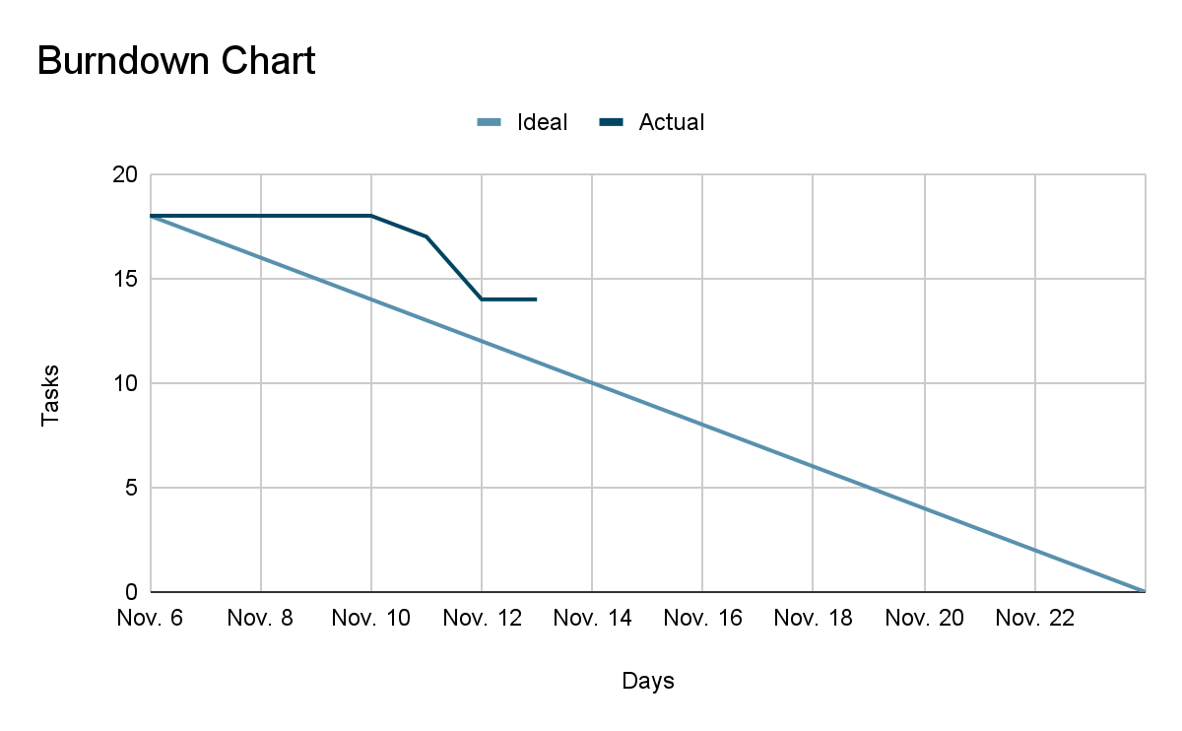

Slide 5
Upcoming
Milestone 1: November 15, 2023
Half of requirements and unit tests
Confident we will reach milestone
Milestone 2: November 22, 2023
All of requirements and unit tests

